Slide 1
Python
Classes and Objects

Slide 2
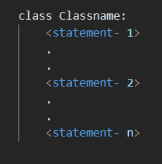
Class in Python
Class
Syntax
The class can be defined as a collection of objects.
It is a logical entity that has some specific attributes and methods.
Like function definitions begin with the def keyword in Python, class definitions begin with a class keyword.

Slide 3
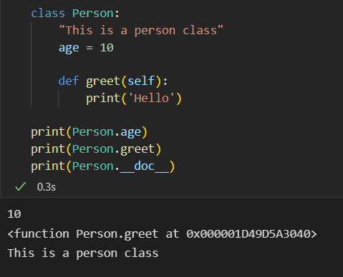
Class in Python
Example

Slide 4

Object in Python
Object
Syntax
An object is simply a collection of data (variables) and methods (functions) that act on those data.

Slide 5
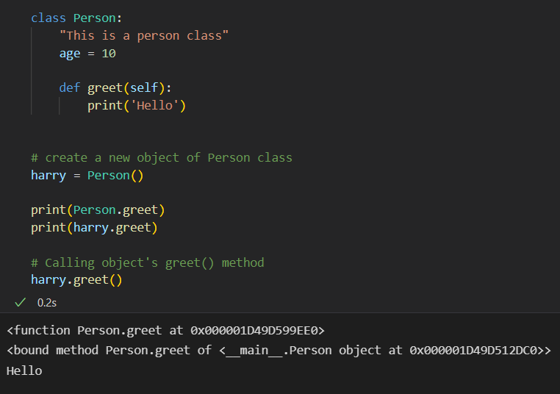
Object in Python
Example

Slide 6



Python Inheritance
Inheritance
Syntax
Inheritance allows us to define a class that inherits all the methods and properties from another class.
Parent class is the class being inherited from, also called base class.
Child class is the class that inherits from another class, also called derived class.

Slide 7
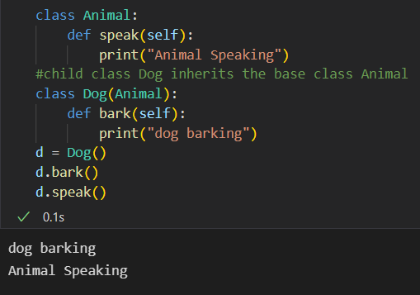
Python Inheritance
Example

Slide 8
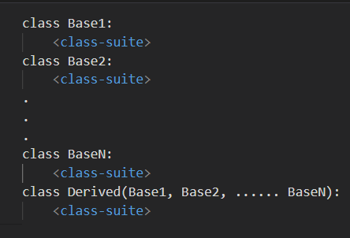
Python Multiple Inheritance
Multiple Inheritance
Syntax
A class can be derived from more than one base class in Python, similar to C++. This is called multiple inheritance.
Base Class 1
Base Class 2
Base Class n
Derived Class

Slide 9
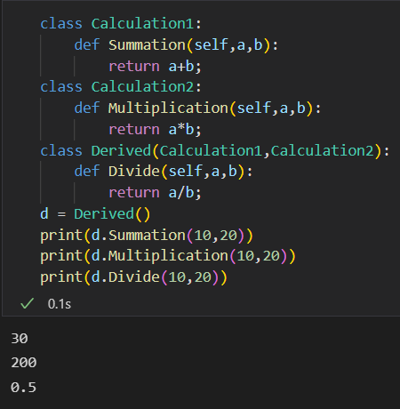
Python Multiple inheritance
Example

Slide 10
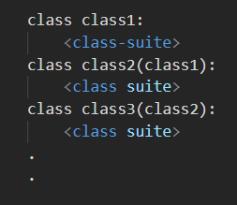
Python Multi-Level Inheritance
Python Multi-Level Inheritance
Syntax
Multi-level inheritance is archived when a derived class inherits another derived class.
There is no limit on the number of levels up to which, the multi-level inheritance is archived in python.
A
Parent Class
B
Child Class
C
Grand Child Class
Here A is the parent class for class B and class B is acting as the parent class for grand-child class C.

Slide 11
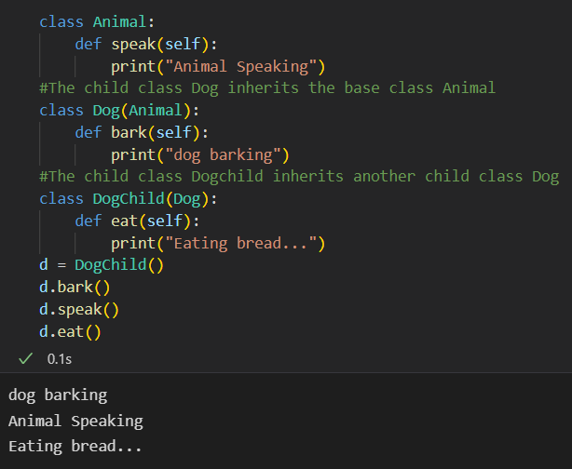
Python Multi-Level Inheritance
Example

Slide 12
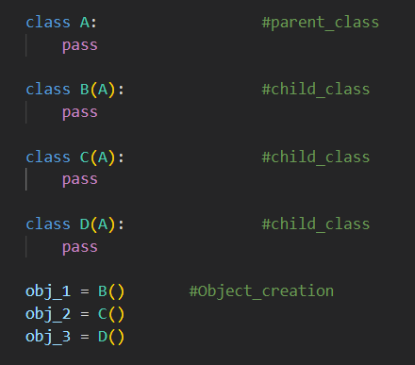
Hierarchical Inheritance
Hierarchical Inheritance
Syntax
When we derive or inherit more than one child class from one(same) parent class. Then this type of inheritance is called hierarchical inheritance.
A
Parent Class
B
C
D
Child Class
Child Class
Child Class

Slide 13
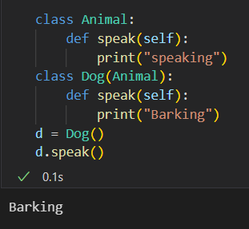
Method Overloading in Python
Method Overriding
Example
When the parent class method is defined in the child class with some specific implementation, then the concept is called method overriding.

Slide 14
THE END

